Slide 1


DAYALBAGH EDUCATIONAL INSTITUTE X
VIRTUAL LABS HACKATHON 2026
Team name: Footwear Team
Leader name: Saurabh Sharma
Institute name: Dayalbagh education institute
PS Title: DEVELOPMENT OF ANAUTOMATIC FOOT MEASUREMENT SYSTEM ARCH SYSTEM USING ARDUINO AND UTRASONIC SENSORS

Slide 2
The Problem Statement
DEI X VIRTUAL LABS HACKATHON 2026
Traditional foot measurement methods used in footwear selection are mostly manual, time-consuming, and prone to human error. These methods generally measure only foot length and width, while ignoring important parameters such as foot arch pressure and plantar pressure distribution. As a result, improper shoe sizing and poor arch support lead to discomfort, foot pain, and long-term orthopedic problems.
Advanced 3D foot scanning systems are available, but they are expensive and not suitable for small footwear industries, retail shops, or educational institutions. Therefore, there is a need for a low-cost, accurate, and automated foot measurement system that can measure foot length, width, and arch pressure efficiently.

Slide 3
Target Users
Footwear Manufacturers
  For accurate foot measurement and arch analysis during shoe design and sizing.
Footwear Retail Stores
  To help customers select correct shoe size and proper arch-support footwear.
Orthopedic Clinics & Podiatrists
  For basic foot screening and arch type identification.
Sports Persons & Athletes
  To select performance shoes based on foot pressure and arch type.
Students & Educational Institutes
  For learning and research in biomechanics, footwear technology, and embedded systems.
Small & Medium Footwear Units (SMEs)
  As a low-cost alternative to expensive 3D foot scanners.
Target Users
Footwear Manufacturers
  For accurate foot measurement and arch analysis during shoe design and sizing.
Footwear Retail Stores
  To help customers select correct shoe size and proper arch-support footwear.
Orthopedic Clinics & Podiatrists
  For basic foot screening and arch type identification.
Sports Persons & Athletes
  To select performance shoes based on foot pressure and arch type.
Students & Educational Institutes
  For learning and research in biomechanics, footwear technology, and embedded systems.
Small & Medium Footwear Units (SMEs)
  As a low-cost alternative to expensive 3D foot scanners.

Slide 4
What Problems Exist Today?
Manual Foot Measurement Errors
  Traditional tape and scale methods are inaccurate and depend on human skill.
Only Length & Width Are Measured
  Important factors like foot arch and pressure distribution are ignored.
Improper Shoe Fit
  Wrong shoe size causes discomfort, blisters, foot pain, and posture issues.
No Arch-Based Footwear Selection
  Flat foot or high arch users are not identified properly.
High Cost of Advanced Systems
  3D foot scanners and pressure-mapping systems are very expensive.
Not Accessible to Small Industries
  Small footwear manufacturers and retail shops cannot afford advanced technology.
Higher Product Returns
  Wrong size and poor comfort lead to increased customer returns and losses.
Lack of Customization
  Footwear is mostly mass-produced, not personalized to foot shape or pressure.

Slide 5
Your Solution & Innovation
DEI X VIRTUAL LAB HACKATHON 2026
DEI X VIRTUAL LABS HACKATHON 2026
What the Solution Aims to Achieve
To develop a low-cost, automatic foot measurement system using Arduino and ultrasonic sensors.
To accurately measure foot length, width, and arch pressure without manual intervention.
Key Features and Functionality
Automatic Measurement of foot length and width using ultrasonic sensors.
Arch Pressure Detection using FSR402 pressure sensor.
Real-time Display of measurements on 16×2 I2C LCD.
Arch Type Identification (Flat / Normal / High).
Audio Alert System using buzzer for abnormal pressure conditions.
User-friendly & Portable Design suitable for retail and lab use.
Low Power and Low Cost hardware implementation.
Alignment with Virtual Labs Mission
Supports hands-on learning through real-time sensor data and embedded system design.
Enables students to experiment, observe, and analyze foot biomechanics virtually and physically.

Slide 6
Architecture Diagram
DEI X VIRTUAL LABS HACKATHON 2026
┌───────────────────────────┐
│ User / Foot │
│ (Placed on Measurement) │
└─────────────┬─────────────┘
│
┌───────────▼───────────┐
│ Sensor Layer │
│ │
│ • Ultrasonic Sensor │───► Foot Length
│ • Ultrasonic Sensor │───► Foot Width
│ • FSR402 Pressure │───► Arch Pressure
│ Sensor │
└───────────┬───────────┘
│ Analog / Digital Signals
┌───────────▼───────────┐
┌───────────▼───────────┐
│ Arduino UNO │
│ (Processing Unit) │
│ │
│ • Data Acquisition │
│ • Signal Processing │
│ • Arch Classification│
└───────┬─────┬─────────┘
│ │
┌─────────▼─┐ ┌─▼─────────┐
│ LCD 16×2 │ │ Buzzer │
│ (I2C) │ │ (Alert) │
└────────────┘ └───────────┘
│
DEI X VIRTUAL LAB HACKATHON 2026

Slide 7
┌─────────▼─────────┐
│ Output Results │
│ │
│ • Foot Length │
│ • Foot Width │
│ • Arch Type │
│ • User Feedback │
└───────────────────┘

Slide 8
Technical Stack
DEI X VIRTUAL LABS HACKATHON 2026
Component | Connected to Arduino Pin
HC-SR04 Trig | Digital Pin 9
HC-SR04 Echo | Digital Pin 10
FSR Sensor | Analog Pin A0 (requires a 10kΩ pull-down resistor)
LCD (SDA/SCL) | Pins A4 & A5
DEI X VIRTUAL LAB HACKATHON 2026

Slide 9
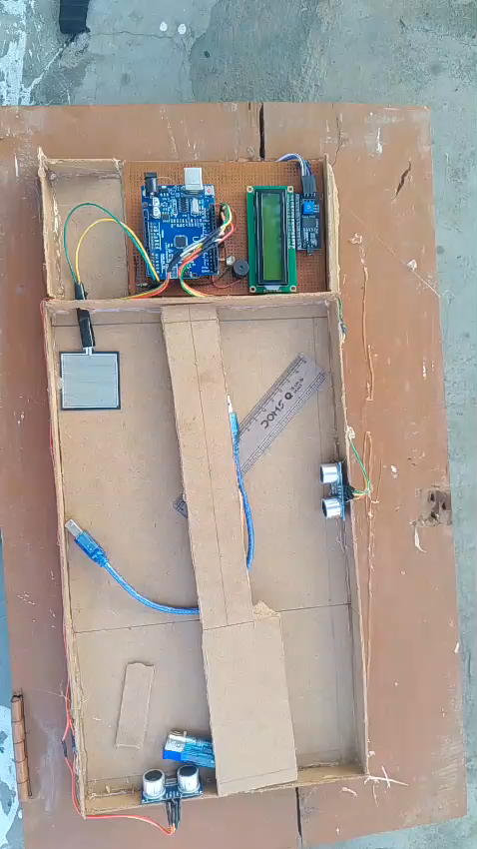
Working product & demo
DEI X VIRTUAL LABS HACKATHON 2026
Link to your demo video (3 min) showcasing walkthrough of your product & its features
https://app.cirkitdesigner.com/project/f8678125-8144-4f5b-bdfb-b81c9f71e1d2
DEI X VIRTUAL LAB HACKATHON 2026

Slide 10
DEI X VIRTUAL LABS HACKATHON 2026
Process Flow (user journey)
System Power ON
Arduino initializes sensors, LCD, and buzzer.
User Instruction Displayed
LCD shows: “Place Foot on Platform”
Foot Placement by User
User places one foot on the measurement platform.
Foot Detection
Ultrasonic sensors detect foot presence and position.
Foot Length Measurement
Front and rear ultrasonic sensors calculate foot length.
Foot Width Measurement
Side ultrasonic sensors measure foot width.
Arch Pressure Sensing
FSR402 sensor measures pressure under the foot arch.
Data Processing
Arduino processes sensor values and applies logic.
Arch Type Classification
System identifies Flat / Normal / High Arch.
Result Display
LCD displays:
  Foot Length
  Foot Width
  Arch Type
Audio Feedback
Buzzer alerts if abnormal arch pressure is detected.
Measurement Complete
LCD shows: “Measurement Completed”
System Reset

Slide 11
User Experience
DEI X VIRTUAL LABS HACKATHON 2026
Simple and Intuitive Use
User only needs to place the foot on the platform; no technical knowledge required.
Quick Measurement
Complete foot measurement is done within a few seconds.
Clear Visual Feedback
Foot length, width, and arch type are clearly displayed on the LCD screen.
Guided Interaction
On-screen instructions guide the user step-by-step.
Minimal Physical Contact
Ultrasonic sensors provide contactless measurement, ensuring hygiene
DEI X VIRTUAL LAB HACKATHON 2026

Slide 12
Challenges and Future scope
DEI X VIRTUAL LABS HACKATHON 2026
Key Challenges
Signal Noise: Ultrasonic waves can scatter on irregular foot shapes.
Environmental Factors: Speed of sound varies with ambient temperature. Future Scope
IoT Integration: ESP32 upgrade for cloud data logging and mobile app syncing.
Machine Learning: Using TinyML to predict gait issues based on pressure patterns.
DEI X VIRTUAL LAB HACKATHON 2026

Slide 13

DEI X VIRTUAL LABS HACKATHON 2026
S

